Slide 1
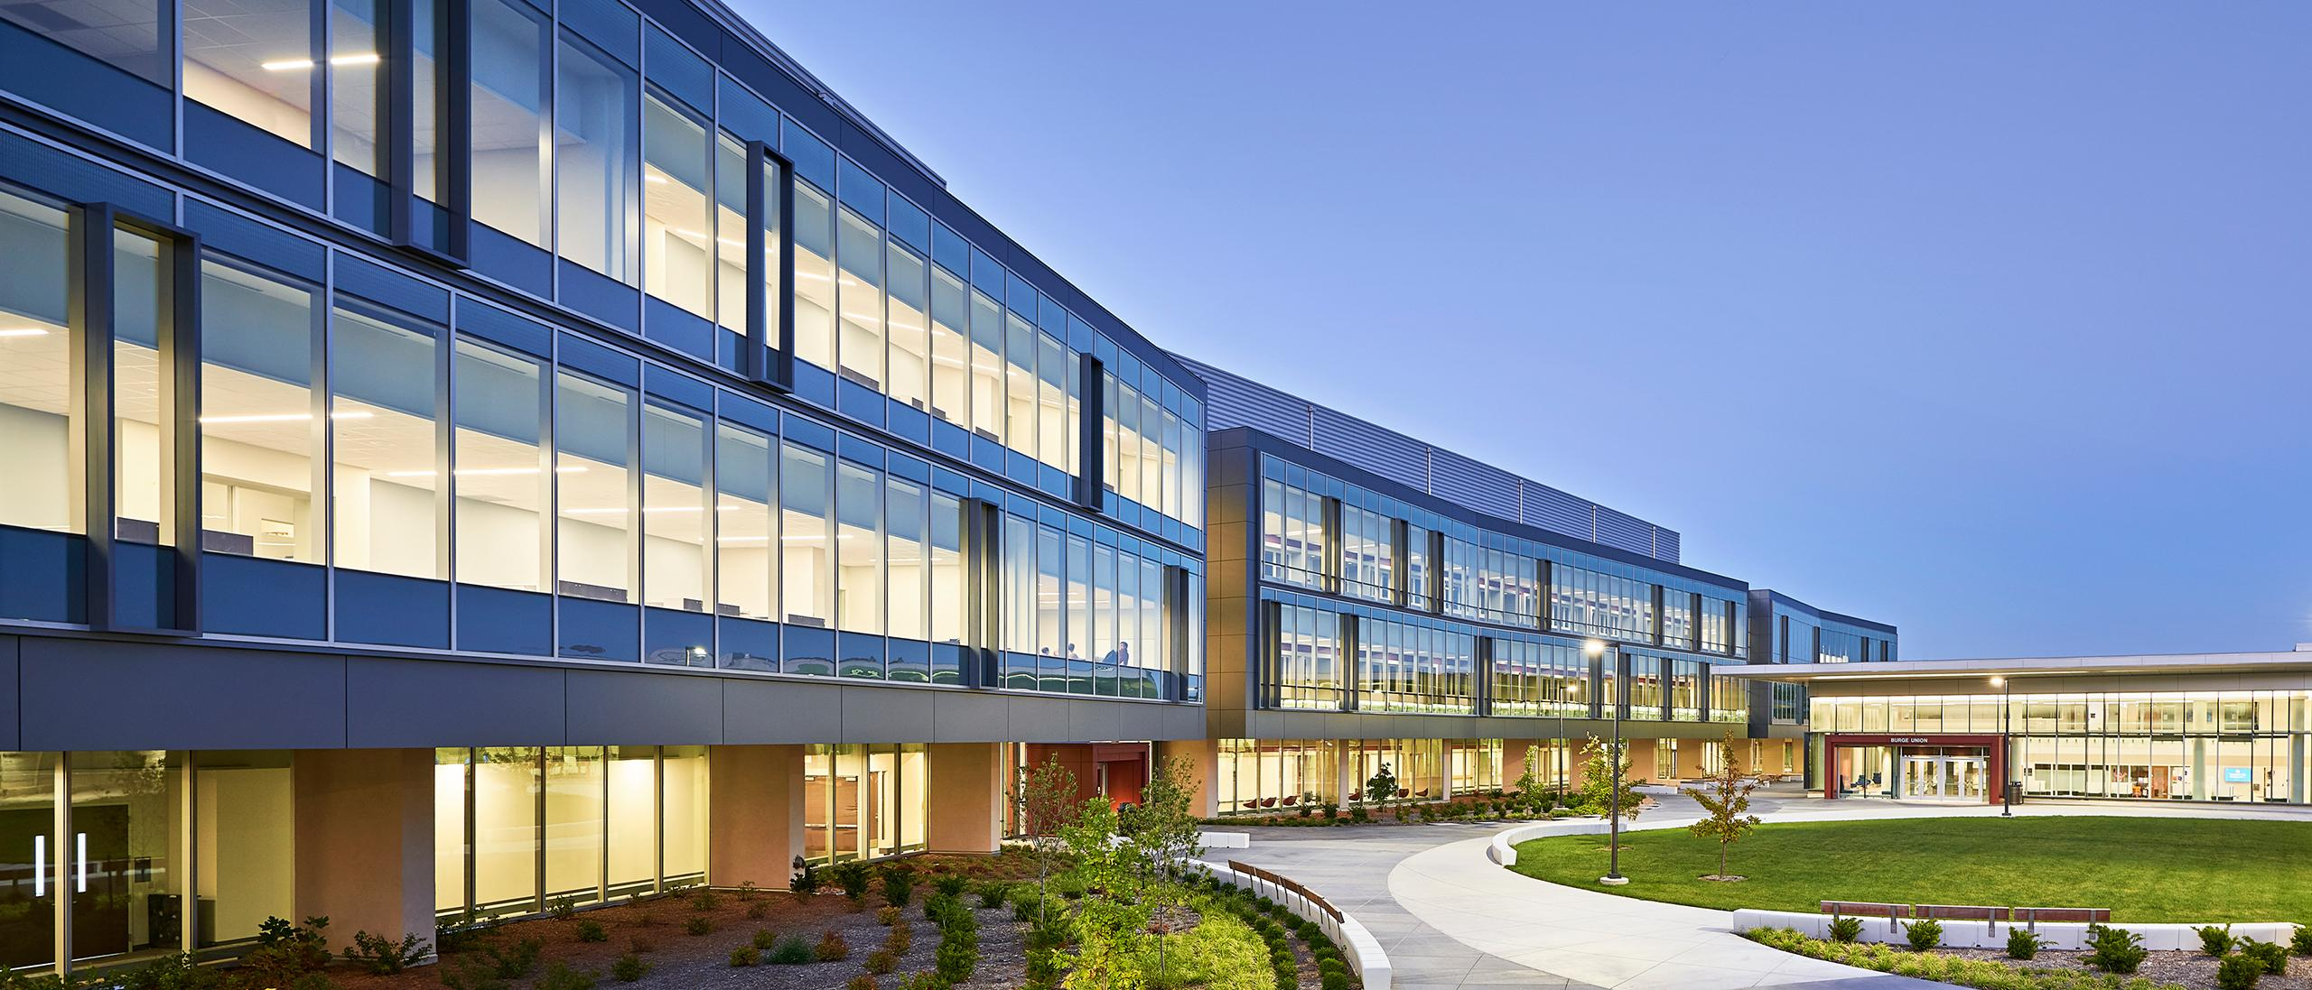
Beyond-CMOS Computing Efficiency as Common Ground in Data Center Expansion
Grant Saggars @ University of Kansas grant-saggars@ku.edu
7 October, 2025

Slide 2
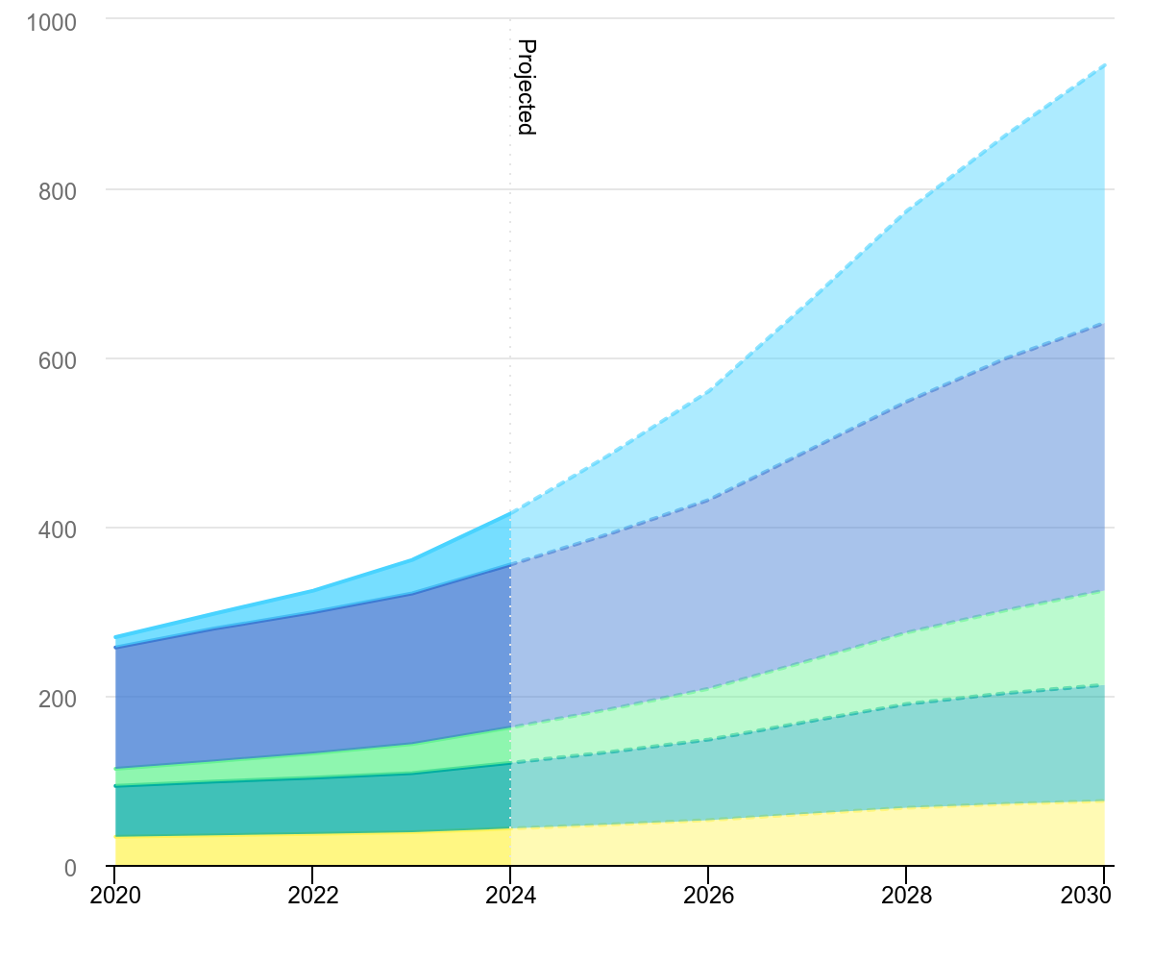
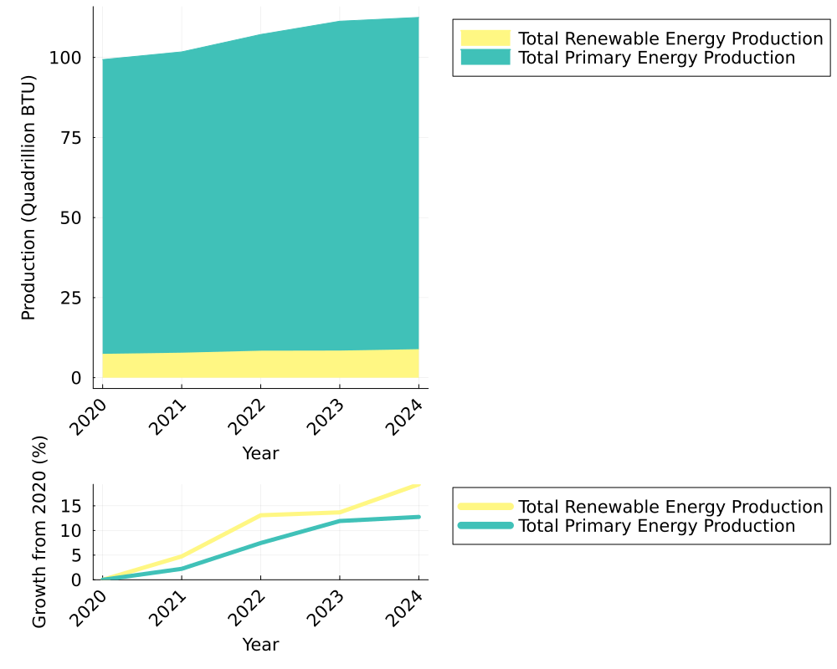
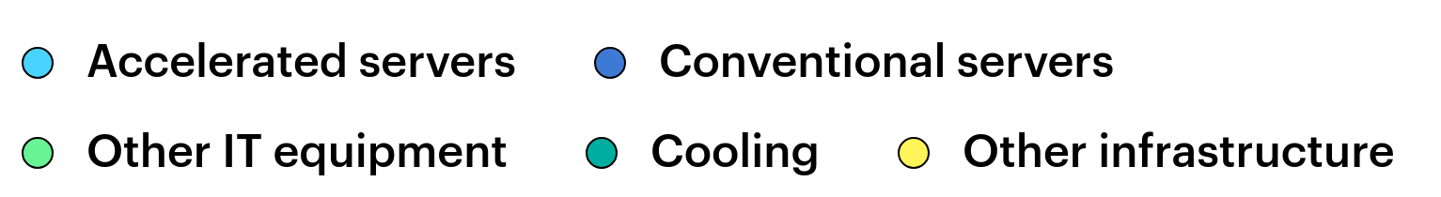
Beyond-CMOS Computing Efficiency as Common Ground in Data Center Expansion
Grant Saggars @ University of Kansas
grant-saggars@ku.edu
25 July, 2025
1) Projected Datacenter Growth
2) Energy Production
(projected)
TWh
IEA (2025), Global data centre electricity consumption, by equipment, Base Case, 2020-2030
U.S. Energy Information Administration. (n.d.). Total Energy Monthly Data. Retrieved October 6, 2025

Slide 3
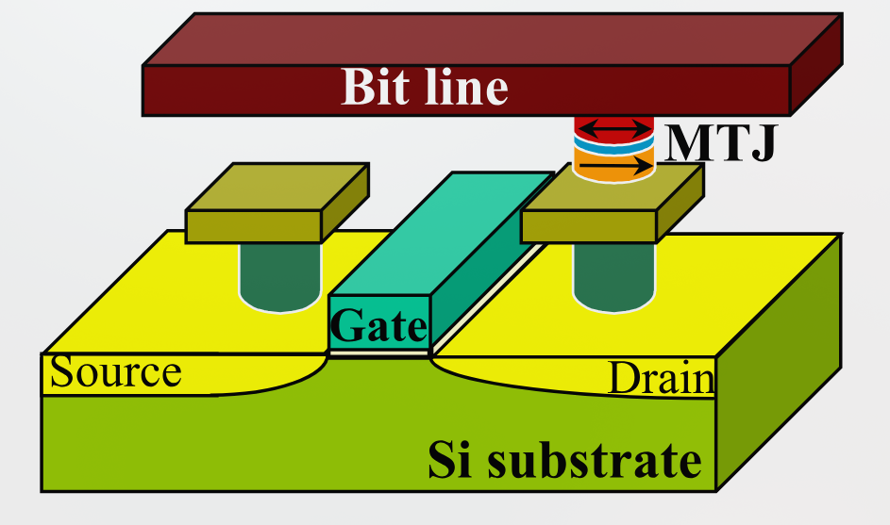
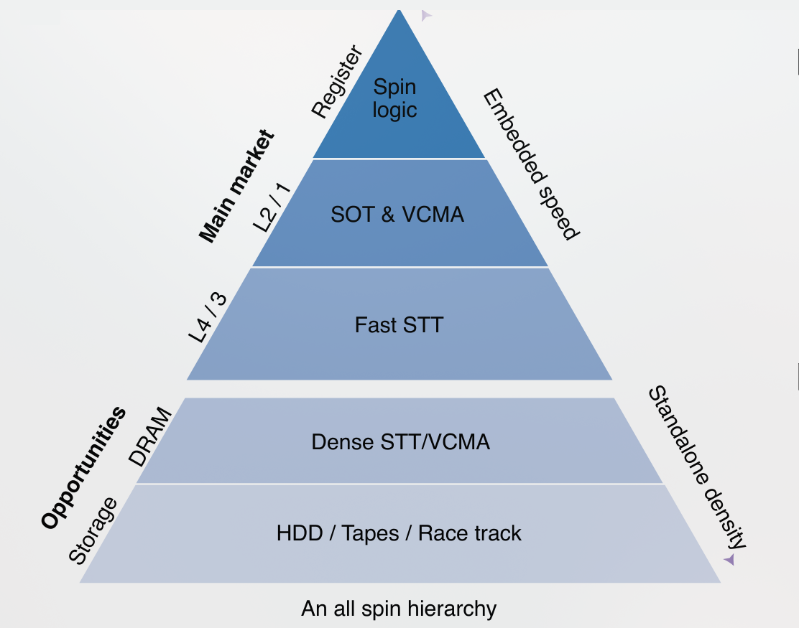
Basic Application and Operation of Magnetoresistive RAM
D. Apalkov et al., Proc. of IEEE 104, 1796 (2016)
Dieny, B., Prejbeanu, I.L., Garello, K. et al. Nat Electron 3, 446–459 (2020).
Current directly switches magnetization of free layer M
High efficiency, low heat production
STT-MRAM most mature; SOT and VCMA-MRAM emerging
Directly integrable using CMOS-fabrication

Slide 4
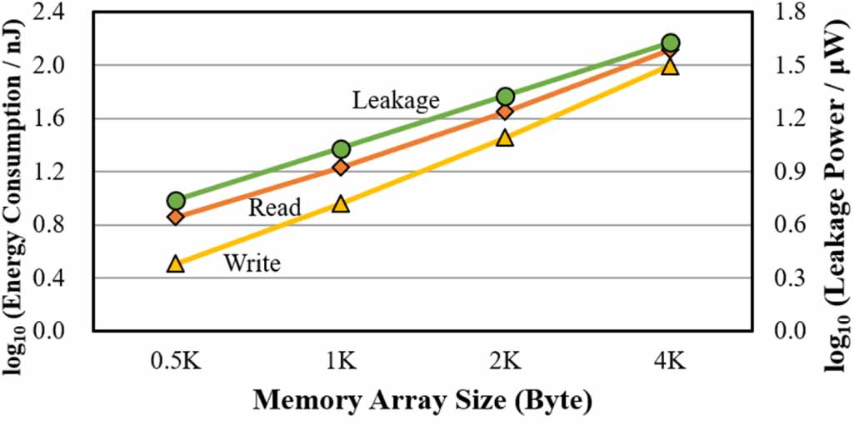
MRAM Specifications
Embedded Flash
  MTJ size 40-100 nm
  Retention: 10 yrs @ 85°C
  Write current > 100 μA
  TMR > 100%
  Endurance 10⁶
Standalone DRAM replacement (GB chips)
  MTJ size <20 nm
  Retention: hours
  Write current < 20 μA
  TMR ~300%
  Endurance 10¹⁷
Yaogeng Liu et al 2025 Semicond. Sci. Technol. 40 035019
Leakage: no capacitors like DRAM
Nonvolatility gives huge energetics advantage
Minimal heating losses

Slide 5
Outlook
STT-MRAM is already entering commerical viability, what are the remaining barriers for industry adoption?
Increase PMA for thermal stability as volume decreases
Further reduce switching current
Etching pitch (higher density)
Increase of TMR to 300% (density, read stability)
Tiffany Santos, 2022, Western Digital, IEEE Distinguished Lecturer

Slide 6

Acknowledgements
“24/7 by 2030: Realizing a Carbon-Free Future” Google Sustainability, https://sustainability.google/reports/247-carbon-free-energy/. Accessed 3 Oct. 2025. “Beyond CMOS: The Future of Semiconductors” IEEE IRDSTM. https://irds.ieee.org/home/what-is-beyond-cmos. Accessed 7 Sep. 2025. Bi, Xiuyuan, et al. “STT-RAM Cell Design Considering CMOS and MTJ Temperature Dependence.” IEEE Transactions on Magnetics, vol. 48, no. 11, Nov. 2012, pp. 3821–24. IEEE Xplore, https://doi.org/10.1109/TMAG.2012.2200469. Cai, Kaiming, et al. “Spin-Based Magnetic Random-Access Memory for High-Performance Computing.” National Science Review, vol. 11, no. 3, Oct. 2023, p. nwad272. PubMed Central, https://doi.org/10.1093/nsr/nwad272. Dieny, B., et al. “Opportunities and Challenges for Spintronics in the Microelectronics Industry.” Nature Electronics, vol. 3, no. 8, Aug. 2020, pp. 446–59. www.nature.com, https://doi.org/10.1038/s41928-020-0461-5. Global Optimism and Amazon. “The Climate Pledge.” The Climate Pledge, https://www.theclimatepledge.com. Accessed 3 Oct. 2025. Hellenbrand, Markus, et al. “Progress of Emerging Non-Volatile Memory Technologies in Industry.” MRS Communications, vol. 14, no. 6, Dec. 2024, pp. 1099–112. Springer Link, https://doi.org/10.1557/s43579-024-00660-2. Hu, G., et al. “Key Parameters Affecting STT-MRAM Switching Efficiency and Improved Device Performance of 400°C-Compatible p-MTJs.” 2017 IEEE International Electron Devices Meeting (IEDM), 2017, p. 38.3.1-38.3.4. IEEE Xplore, https://doi.org/10.1109/IEDM.2017.8268515. Joshi, Vinod Kumar, et al. “From MTJ Device to Hybrid CMOS/MTJ Circuits: A Review.” IEEE Access, vol. 8, 2020, pp. 194105–46. IEEE Xplore, https://doi.org/10.1109/ACCESS.2020.3033023. Khalili Amiri, Pedram, et al. “Electric-Field-Controlled Magnetoelectric RAM: Progress, Challenges, and Scaling.” IEEE Transactions on Magnetics, vol. 51, no. 11, Nov. 2015, pp. 1–7. IEEE Xplore, https://doi.org/10.1109/TMAG.2015.2443124. Kim, Woojin, et al. “VCMA-MTJ: Towards Ghz Operation Low Power MRAM.” 2023 IEEE International Magnetic Conference - Short Papers (INTERMAG Short Papers), 2023, pp. 1–2. IEEE Xplore, https://doi.org/10.1109/INTERMAGShortPapers58606.2023.10228494. Lam, Chester. Alder Lake’s Caching and Power Efficiency. 24 Aug. 2025, https://chipsandcheese.com/p/alder-lakes-caching-and-power-efficiency. Li, Yueting, et al. “Work-in-Progress: Toward Energy-Efficient Near STT-MRAM Processing Architecture for Neural Networks.” 2022 International Conference on Hardware/Software Codesign and System Synthesis (CODES+ISSS), 2022, pp. 13–14. IEEE Xplore, https://doi.org/10.1109/CODES-ISSS55005.2022.00013. Manchon, A., et al. “Current-Induced Spin-Orbit Torques in Ferromagnetic and Antiferromagnetic Systems.” Reviews of Modern Physics, vol. 91, no. 3, Sep. 2019, p. 035004. DOI.org (Crossref), https://doi.org/10.1103/RevModPhys.91.035004. United States, Energy Information Administration. Monthly Energy Review. Aug. 2025, www.eia.gov/totalenergy/data/monthly/pdf/mer.pdf. Accessed 3 Oct. 2025. International Energy Agency. "Emission Reductions." Multiple Benefits of Energy Efficiency, IEA, 2019, iea.blob.core.windows.net/assets/7d547730-44ff-404b-af52-0812a340aee5/MultipleBenefitsofEnergyEfficiency-EmissionReductions.pdf. Accessed 3 Oct. 2025. Nguyen, V. D., et al. “Recent Progress in Spin-Orbit Torque Magnetic Random-Access Memory.” Npj Spintronics, vol. 2, no. 1, Oct. 2024, p. 48. www.nature.com, https://doi.org/10.1038/s44306-024-00044-1. Paullin, Charlie. “Legislative Report: Development of Data Centers Could Triple Energy Demands If Unconstrained • Virginia Mercury.” Virginia Mercury, 9 Dec. 2024, https://virginiamercury.com/2024/12/09/legislative-report-development-of-data-centers-could-triple-energy-demands-if-unconstrained/. United States, Congress, House. One Big Beautiful Bill Act. Congress.gov, www.congress.gov/bill/119th-congress/house-bill/1. 119th Congress, H.R. 1, enacted 4 July 2025. Shehabi, Arman, et al. United States Data Center Energy Usage Report. LBNL--1005775, 1372902, 1 Jun. 2016, p. LBNL--1005775, 1372902. DOI.org (Crossref), https://doi.org/10.2172/1372902. Song, Cheng, et al. “Recent Progress in Voltage Control of Magnetism: Materials, Mechanisms, and Performance.” Progress in Materials Science, vol. 87, Jun. 2017, pp. 33–82. ScienceDirect, https://doi.org/10.1016/j.pmatsci.2017.02.002. Total Energy Monthly Data - U.S. Energy Information Administration (EIA). https://www.eia.gov/totalenergy/data/monthly/. Accessed 9 Sep. 2025. “Tracking Clean Energy Progress 2023 – Analysis.” IEA, 12 Jul. 2023, https://www.iea.org/reports/tracking-clean-energy-progress-2023. Van Geet, Otto, and David Sickinger. Best Practices Guide for Energy-Efficient Data Center Design. NREL/TP--5R00-89843, DOE/GO--102024-6283, 2417618, 25 Jul. 2024, p. NREL/TP--5R00-89843, DOE/GO--102024-6283, 2417618. DOI.org (Crossref), https://doi.org/10.2172/2417618. Yang, Hyunsoo, et al. “Two-Dimensional Materials Prospects for Non-Volatile Spintronic Memories.” Nature, vol. 606, no. 7915, Jun. 2022, pp. 663–73. www.nature.com, https://doi.org/10.1038/s41586-022-04768-0. Yusuf, Alaba, et al. “Domain-Specific STT-MRAM-Based In-Memory Computing: A Survey.” IEEE Access, vol. 12, 2024, pp. 28036–56. IEEE Xplore, https://doi.org/10.1109/ACCESS.2024.3365632.
Additional Acknowledgements
IEA (2025), Global data centre electricity consumption, by equipment, Base Case, 2020-2030
U.S. Energy Information Administration. (n.d.). Total Energy Monthly Data. Retrieved October 6, 2025
Dieny, B., Prejbeanu, I.L., Garello, K. et al. Nat Electron 3, 446–459 (2020).
D. Apalkov et al., Proc. of IEEE 104, 1796 (2016)
Yaogeng Liu et al 2025 Semicond. Sci. Technol. 40 035019
Tiffany Santos, 2022, Western Digital, IEEE Distinguished Lecturer

